Slide 1
19CSE305: MACHINE LEARNING DECISION TREES

Slide 2
Decision Trees
Classic and natural model of learning
Based on fundamental computer science notion of “divide and conquer”
It creates a model that predicts the value of a target variable based on several input variables
A tree can be learned by splitting the source set into subsets based on an attribute value test using recursive partitioning
The recursion is completed when the subset at a node has all the same value of the target variable, or when splitting no longer adds value to the predictions.
Although decision trees can be applied to many learning problems, we will begin with the simplest case: binary classification

Slide 3
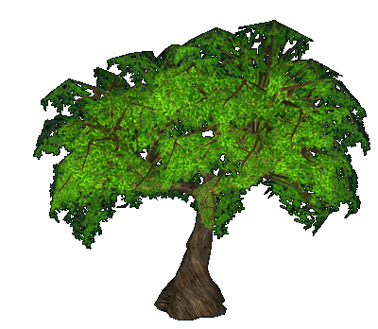
Decision Trees
One of the most popular machine learning algorithms
Can be used for both classification and regression problems
Decision tress often mimic the human level thinking so its so simple to understand the data and make some good interpretations.
Decision trees actually make you see the logic for the data to interpret(not like black box algorithms like SVM,NN,etc..)
Why Decision trees?

Slide 4
The decision tree model of learning
Do people like movies of Amitabachan?

Slide 5
The decision tree model of learning
Do people like movies of Amitabachan?
Q : Is the genre of movie is “Action”?
Yes
Q : Is the lead actor is Amitabachan?
Yes
Q : Has people liked previous Action movie of the Amitabachan?
Yes
People do like Action movies of Amitabachan

Slide 6
The decision tree model of learning
Do people like movies of Amitabachan?
Q : Is the genre of movie is “Comedy”?
Yes
Q : Is the lead actor is Amitabachan?
Yes
Q : Has people liked previous comedy movie of the Amitabachan?
No
People don’t like Comedy movies of Amitabachan

Slide 7
The decision tree model of learning
Goal of learner: Figure out what questions to ask, and in what order, and what to predict when you have answered enough questions

Slide 8
The decision tree model of learning
Lead Actor | Genre | Hit(Y/N)
Amitabh Bacchan | Action | Yes
Amitabh Bacchan | Fiction | Yes
Amitabh Bacchan | Romance | No
Amitabh Bacchan | Action | Yes
Abhishek Bacchan | Action | No
Abhishek Bacchan | Fiction | No
Abhishek Bacchan | Romance | Yes

Slide 9
The decision tree model of learning
Lead Actor | Genre | Hit(Y/N)
Amitabh Bacchan | Action | Yes
Amitabh Bacchan | Fiction | Yes
Amitabh Bacchan | Romance | No
Amitabh Bacchan | Action | Yes
Abhishek Bacchan | Action | No
Abhishek Bacchan | Fiction | No
Abhishek Bacchan | Romance | Yes
Questions are features
Responses are feature values
Decision is the label

Slide 10
Why it’s Decision Tree?
Lead Actor | Genre | Hit(Y/N)
Amitabh Bacchan | Action | Yes
Amitabh Bacchan | Fiction | Yes
Amitabh Bacchan | Romance | No
Amitabh Bacchan | Action | Yes
Abhishek Bacchan | Action | No
Abhishek Bacchan | Fiction | No
Abhishek Bacchan | Romance | Yes

Slide 11
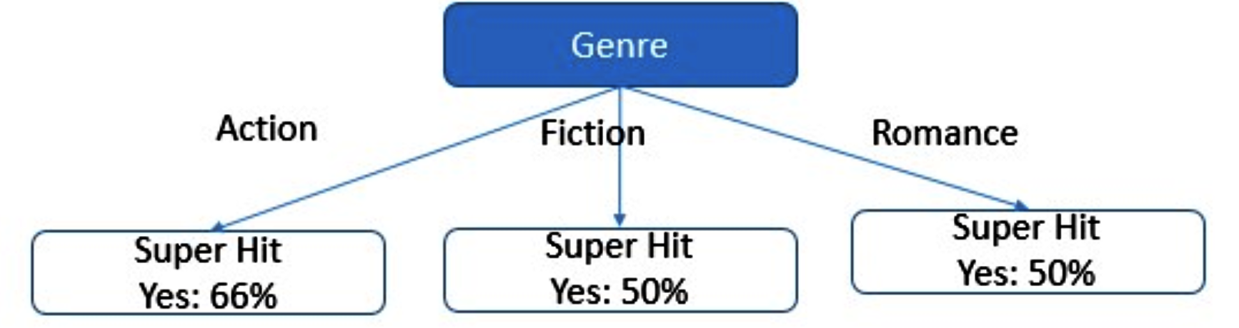
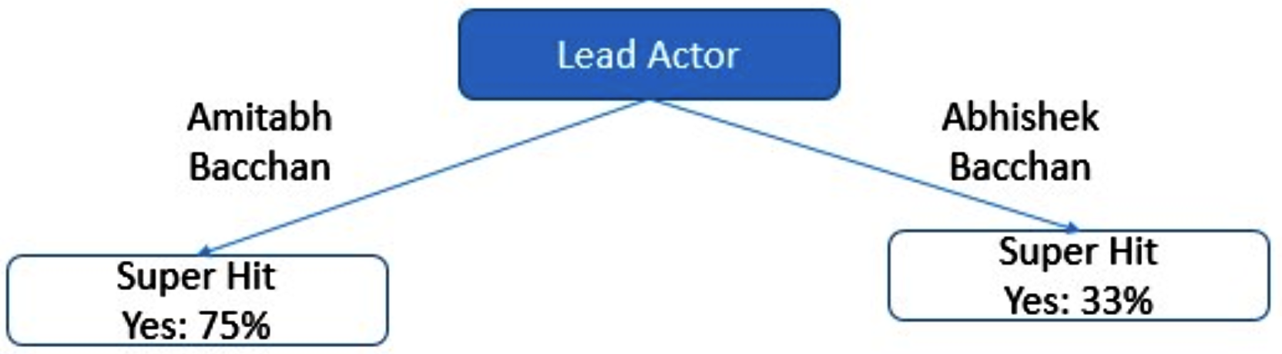
Why it’s Decision Tree?
Lead Actor | Genre | Hit(Y/N)
Amitabh Bacchan | Action | Yes
Amitabh Bacchan | Fiction | Yes
Amitabh Bacchan | Romance | No
Amitabh Bacchan | Action | Yes
Abhishek Bacchan | Action | No
Abhishek Bacchan | Fiction | No
Abhishek Bacchan | Romance | Yes
We can represent set of questions and guesses in a tree format

Slide 12
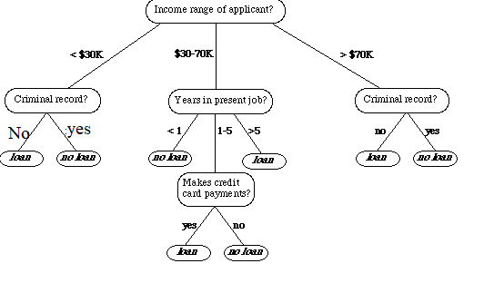
Decision Trees
Example 2
If we are classifying bank loan application for a customer, the decision tree may look like this

Slide 13
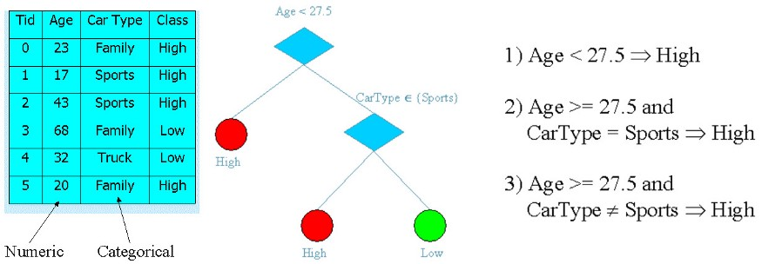
Decision Trees
What is a Decision tree?
A decision tree is a tree where each node represents a feature(attribute), each link(branch) represents a decision(rule) and each leaf represents an outcome(categorical or continues value).
Create a tree for the entire data and process a single outcome at every leaf(or minimize the error in every leaf).

Slide 14
Terminologies
Root Node
A
3 Types of nodes:
Root Node
Branch Node
Leaf Node
F
T
B
B
Branch Node
F
T
T
F
F
T
T
F
Benefits
It does not require any domain knowledge.
It is easy to comprehend.
The learning and classification steps of a decision tree are simple and fast.
Leaf Node

Slide 15
Classification—A Two-Step Process [RECAP]
Model construction: describing a set of predetermined classes
Each tuple/sample is assumed to belong to a predefined class, as determined by the class label attribute
The set of tuples used for model construction is training set
The model is represented as classification rules, decision trees, or mathematical formulae
Model usage: for classifying future or unknown objects
Estimate accuracy of the model
The known label of test sample is compared with the classified result from the model
Accuracy rate is the percentage of test set samples that are correctly classified by the model
Test set is independent of training set (otherwise overfitting)
If the accuracy is acceptable, use the model to classify new data
Note: If the test set is used to select models, it is called validation (test) set

Slide 16
Illustrating Classification Task

Slide 17
Decision Tree-Classification Task
categorical
categorical
continuous
class
Splitting Attributes
Refund
Yes
No
NO
MarSt
Single, Divorced
Married
TaxInc
NO
< 80K
> 80K
NO
YES
Training Data
Model: Decision Tree

Slide 18
Another Example of Decision Tree
categorical
categorical
continuous
class
MarSt
Single, Divorced
Married
NO
Refund
Yes
No
NO
TaxInc
< 80K
> 80K
NO
YES
There could be more than one tree that fits the same data!

Slide 19
Apply Model to Test Data
Test Data
Start from the root of tree.
Refund
Yes
No
NO
MarSt
Single, Divorced
Married
TaxInc
NO
< 80K
> 80K
NO
YES

Slide 20
Apply Model to Test Data
Test Data
Refund
Yes
No
NO
MarSt
Single, Divorced
Married
TaxInc
NO
< 80K
> 80K
NO
YES

Slide 21
Apply Model to Test Data
Test Data
Refund
Yes
No
NO
MarSt
Single, Divorced
Married
TaxInc
NO
< 80K
> 80K
NO
YES

Slide 22
Apply Model to Test Data
Test Data
Refund
Yes
No
NO
MarSt
Single, Divorced
Married
TaxInc
NO
< 80K
> 80K
NO
YES

Slide 23
Apply Model to Test Data
Test Data
Refund
Yes
No
NO
MarSt
Single, Divorced
Married
TaxInc
NO
< 80K
> 80K
NO
YES

Slide 24
Apply Model to Test Data
Test Data
Refund
Yes
No
NO
MarSt
Single, Divorced
Married
Assign Cheat to “No”
TaxInc
NO
< 80K
> 80K
NO
YES

Slide 25
Decision Tree Classification Task
Decision Tree

Slide 26
Decision tree algorithms
Determine the attribute that best classifies the training data; use this attribute at the root of the tree. Repeat this process at for each branch
ID3 (Iterative Dichotomiser 3) → uses Entropy function and Information gain as metrics.
CART (Classification and Regression Trees) → uses Gini Index(Classification) as metric.
Hunt’s Algorithm (one of the earliest)
C4.5, 5.0
CHAID (CHi-squared Automatic Interaction Detector)
MARS (Multivariate Adaptive Regression Splines)
Conditional Inference Trees

Slide 27
ID3 (Iterative Dichotomiser 3)
Assume that the attributes are categorical
The attribute with a high information gain value is placed at the root.
• Developed by J. Ross Quinlan in 1979
Quinlan was a computer science researcher in data mining, and decision theory.
Received doctorate in computer science at the University of Washington in 1968.
• Based on Entropy
• Only works for discrete data
• Can not work with defective data

Slide 28
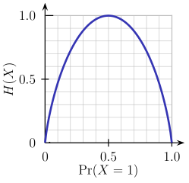
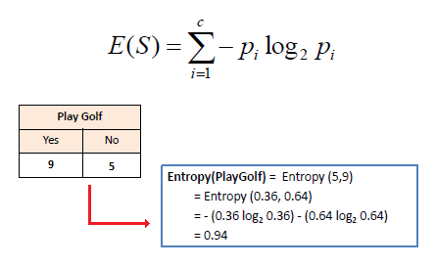
Entropy
Entropy is a measure of the randomness in the information being processed. The higher the entropy, the harder it is to draw any conclusions from that information
Flipping a coin
The entropy H(X) is zero when the probability is either 0 or 1.
The Entropy is maximum when the probability is 0.5

Slide 29
Entropy
Entropy(Play Golf)= Entropy(Yes) + Entropy(No)
Entropy(Play Golf)= 0.94

Slide 30
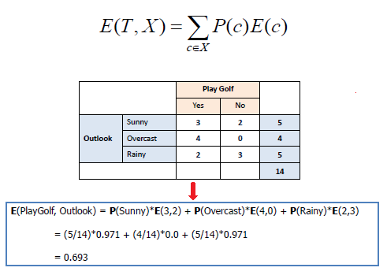
Entropy of multiple attributes

Slide 31
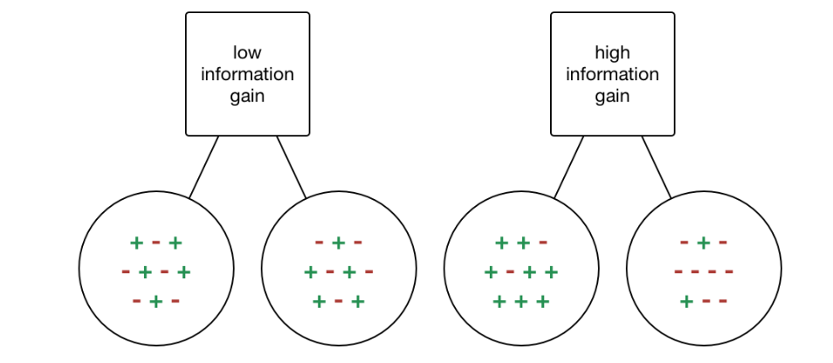
Information Gain
Information gain or IG is a statistical property that measures how well a given attribute separates the training examples according to their target classification.
Find an attribute that returns the highest information gain and the smallest entropy.

Slide 32
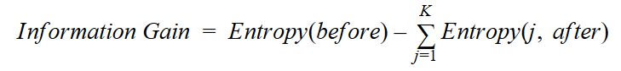
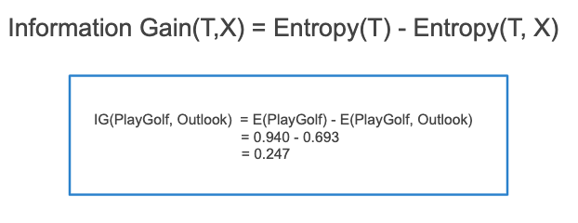
Information Gain
IG computes the difference between entropy before split and entropy after split of the dataset based on given attribute values.

Slide 33
Algorithm for Decision Tree Induction
Basic algorithm (a greedy algorithm)
Tree is constructed in a top-down recursive divide-and-conquer manner
At start, all the training examples are at the root
Attributes are categorical (if continuous-valued, they are discretized in advance)
Examples are partitioned recursively based on selected attributes
Test attributes are selected on the basis of a heuristic or statistical measure (e.g., information gain)
Conditions for stopping partitioning
All samples for a given node belong to the same class
There are no remaining attributes for further partitioning – majority voting is employed for classifying the leaf
There are no samples left

Slide 34
ID3 Algorithm
compute the entropy for data-set
For every attribute/feature:
2.1 calculate entropy for all categorical values 2.2 take average information entropy for the current attribute 2.3 calculate gain for the current attribute
3. pick the highest gain attribute. 4. Repeat until we get the tree we desired.

Slide 35
Pros of ID3 Algorithm
Builds decision tree in minimum steps
Each level benefits from previous level choices
Whole dataset is scanned to create tree

Slide 36
Cons of ID3 Algorithm
Tree can not be updated when new data is classified incorrectly, instead a new tree must be generated.
Only one attribute at a time is tested for making a decision.
Can not work with defective data
Can not work with numerical attributes

Slide 37
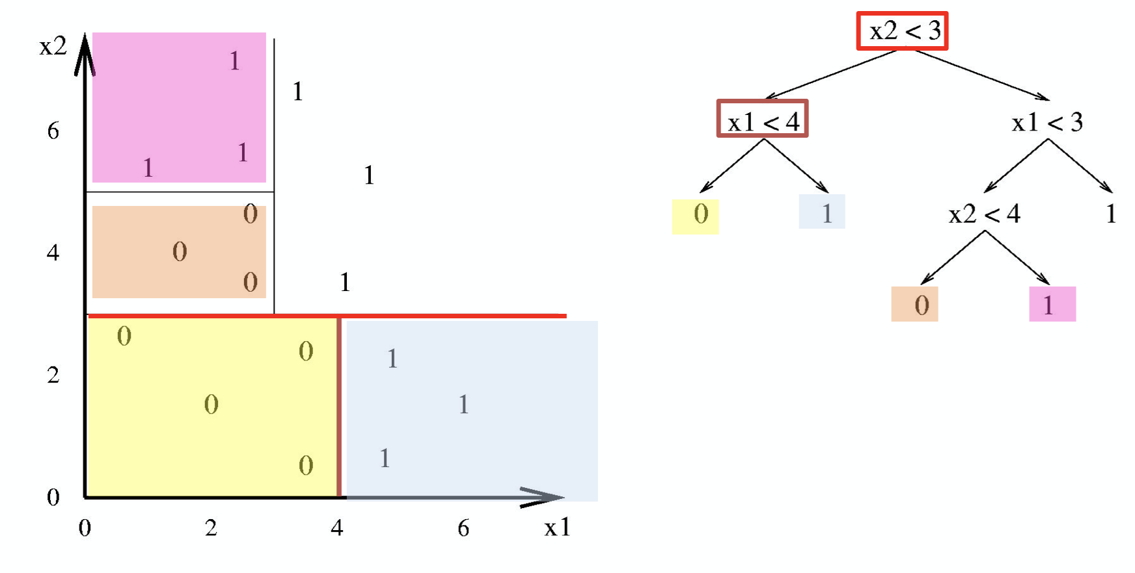
Decision Tree Boundary

Slide 38
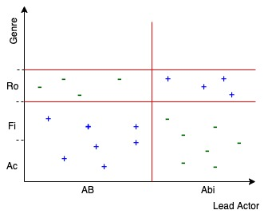
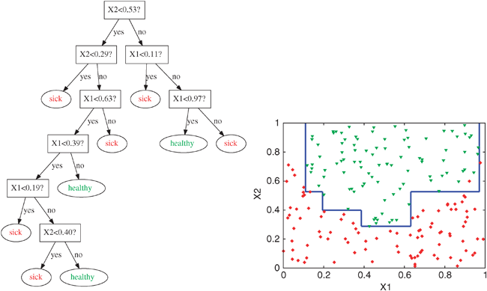
Decision Tree Boundary

Slide 39
THANK YOU

